Slide 1
Addressing Radiology Recommendations Collaboratively (ARRC)
Ensuring timely performance when clinically necessary
Team Leads: Neena Kapoor, MD; Sonali Desai, MD, MPH
Executive Sponsor: Ramin Khorasani, MD, MPH
Oversight Committee, July 12, 2023

Slide 2
ARRC Oversight Committee – 07/12/2023
Contents
Cumulative Metrics
Previous Month Summary
Alert Status Updates

Slide 3
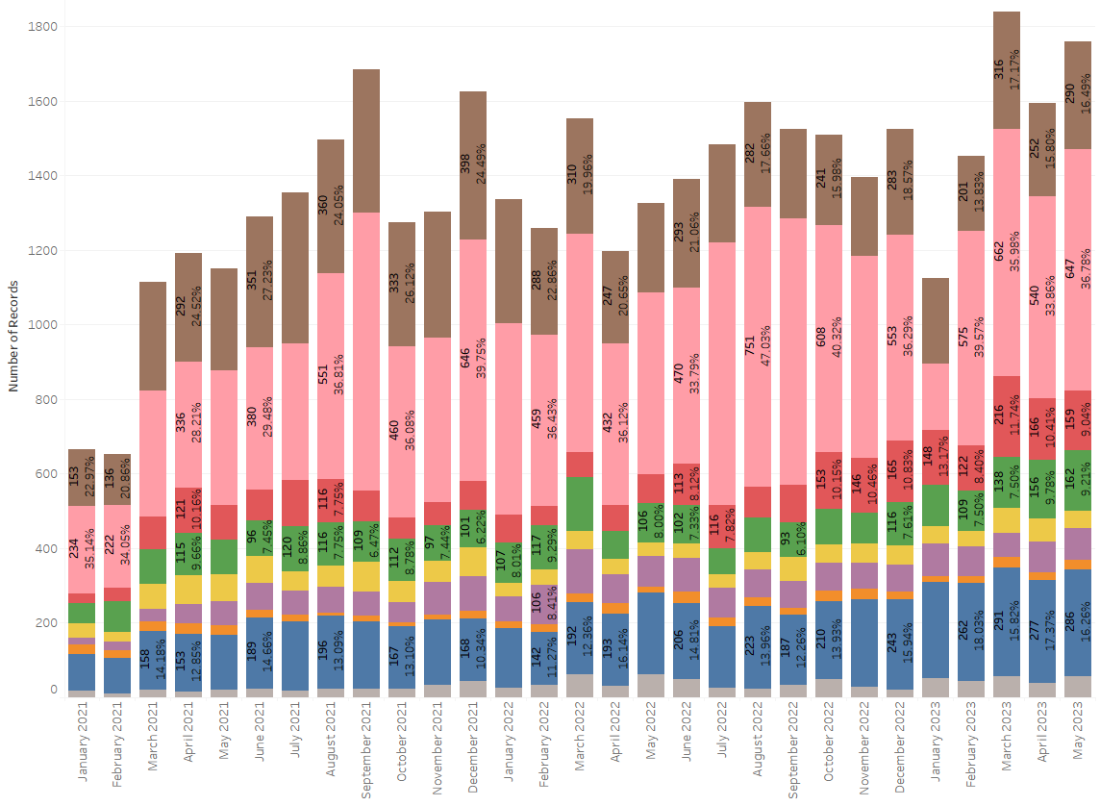
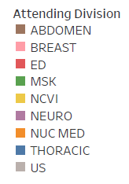
Cumulative Metrics
Notes:
Numbers on this slide include BI-RADS 3 Mammo & US. They also include ARRC Page.

Slide 4
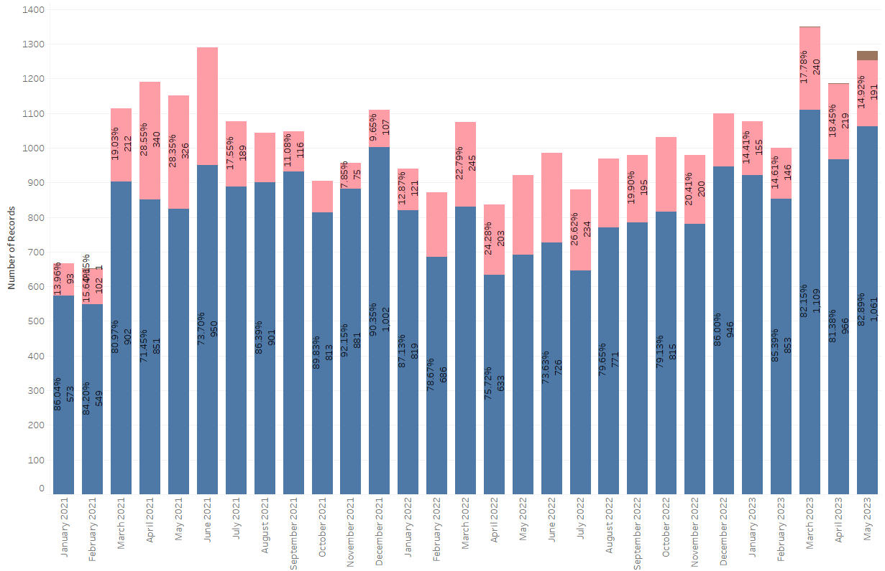
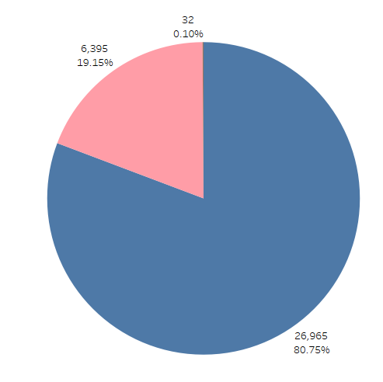
Cumulative Metrics
Notes:
Pie Chart: Overall, Safety Net is acting on ~19% of follow-up alerts. Of note, includes all alerts in OneDrive that have indicated any Safety Net action (acknowledged by Safety Net, Safety Net in progress, Safety Net sent letter, etc.).
Numbers on this slide do not include BI-RADS 3 Mammo & US.

Slide 5
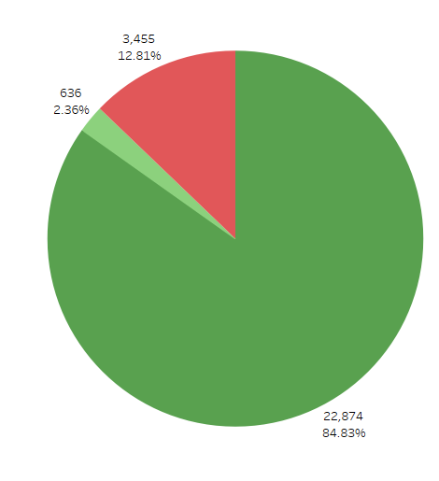
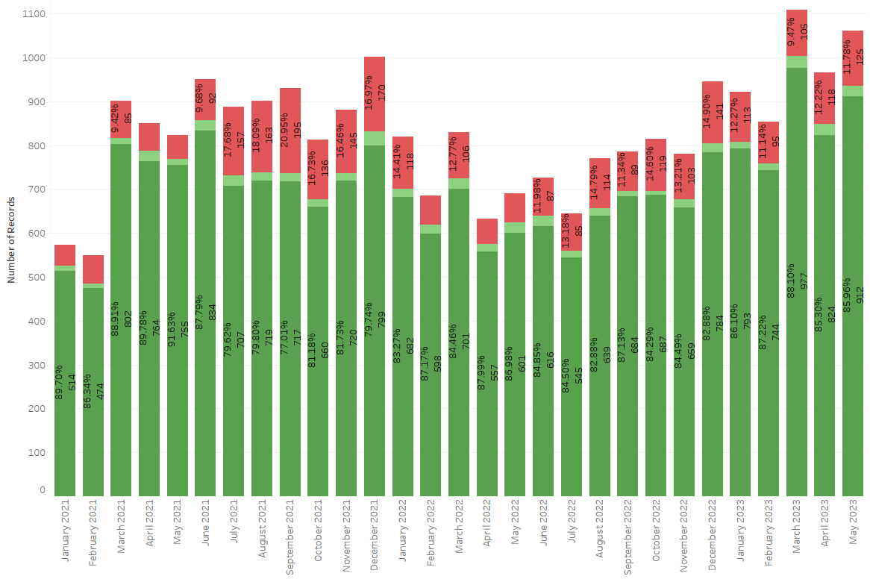
Cumulative Metrics
Notes:
Pie Chart: Overall, referring providers disagree with ~13% of follow-up recommendations.
Numbers on this slide do not include BI-RADS 3 Mammo & US.

Slide 6
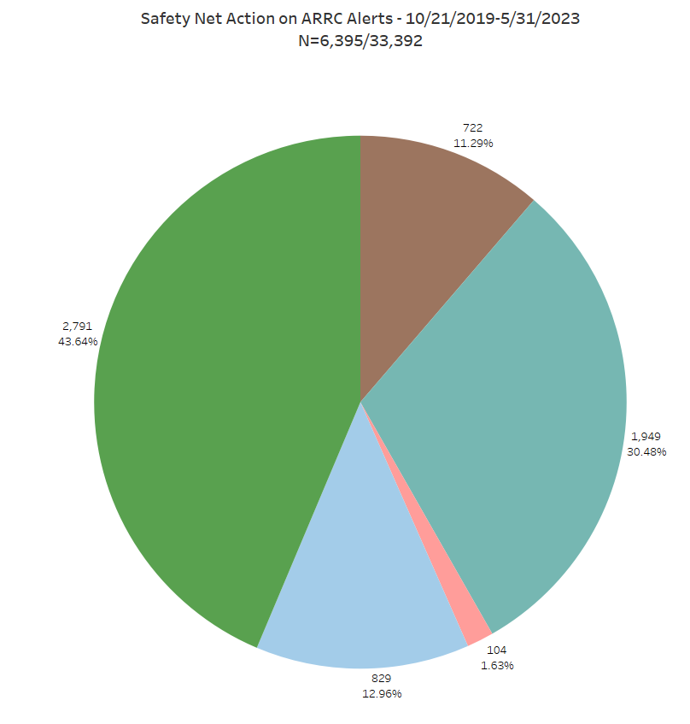
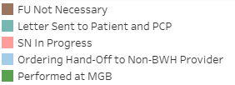
Cumulative Metrics
Notes:
Slide request by Safety Net – more detail as to the actions of Safety Net.
Numbers on this slide do not include BI-RADS 3 Mammo & US.

Slide 7
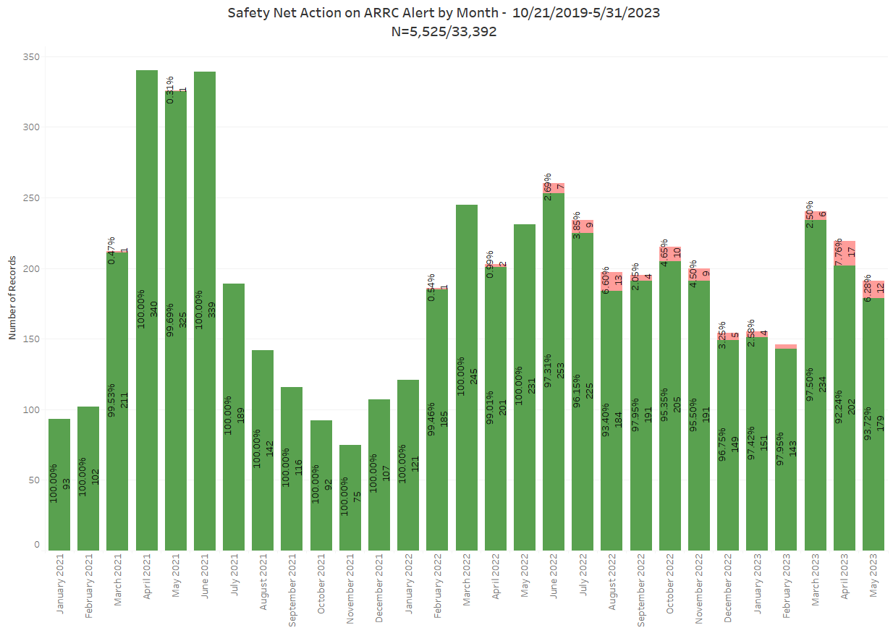
Cumulative Metrics
Notes:
Slide request by Safety Net – see the results of Safety Net work over time.
Numbers on this slide do not include BI-RADS 3 Mammo & US.

Slide 8
Previous Month Summary
June 2023 ARRC alerts:
1,179 ARRC alerts generated
929 (79%) follow-up alerts acknowledged
433 (47%) follow-up alerts sent directly to Brigham Radiology Care Coordination (minimized leakage)
0% disagreement from ordering providers
555 BI-RADS 3 recommendations generated

Slide 9
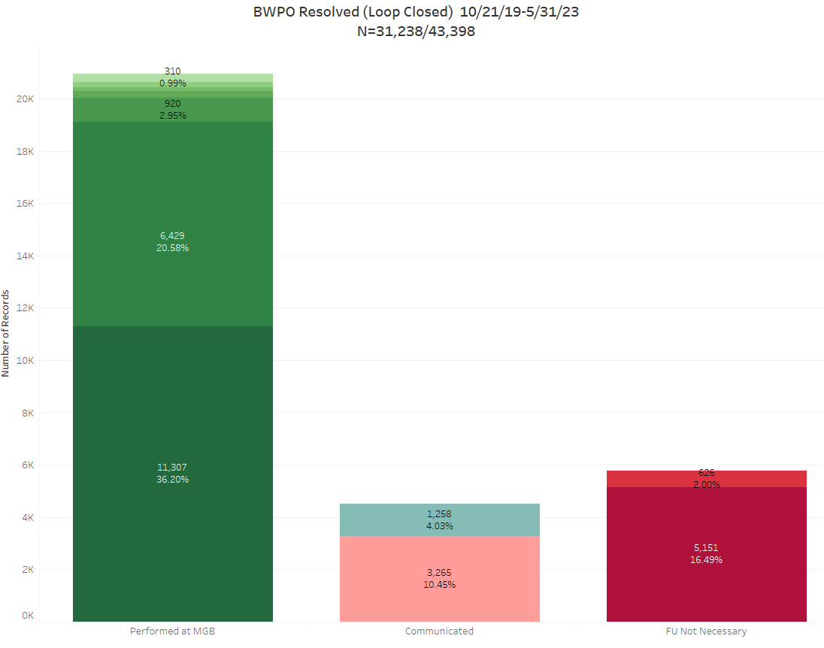
Alert Status Updates
Notes:
Numbers on this slide include BI-RADS 3 Mammo & US.
Resolved (Loop Closed)

Slide 10
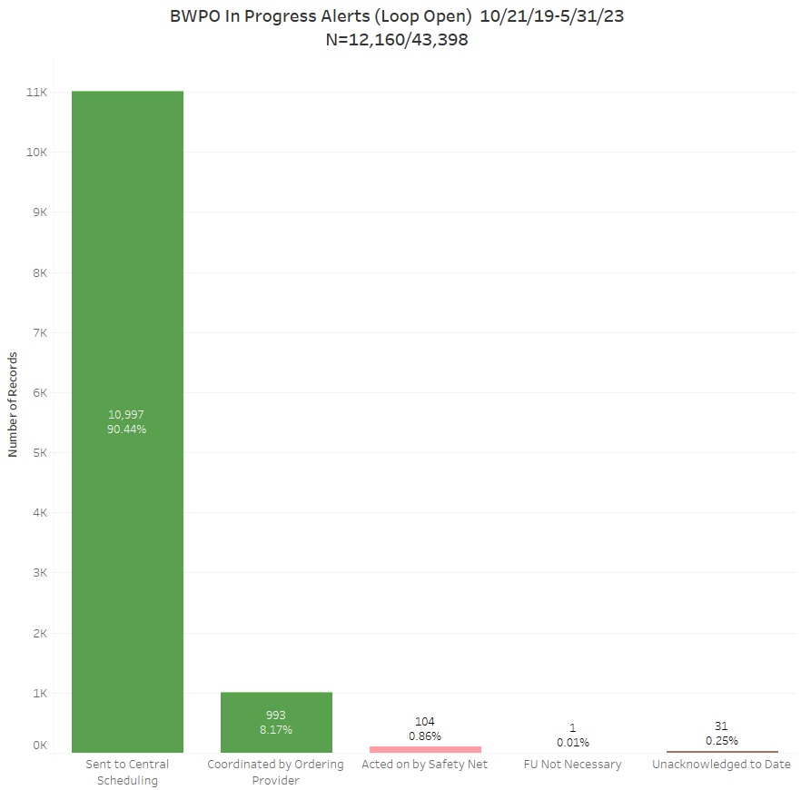
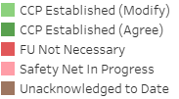
Alert Status Updates
Notes:
Numbers on this slide include BI-RADS 3 Mammo & US.
In Progress (Loop Open)

